Slide 1
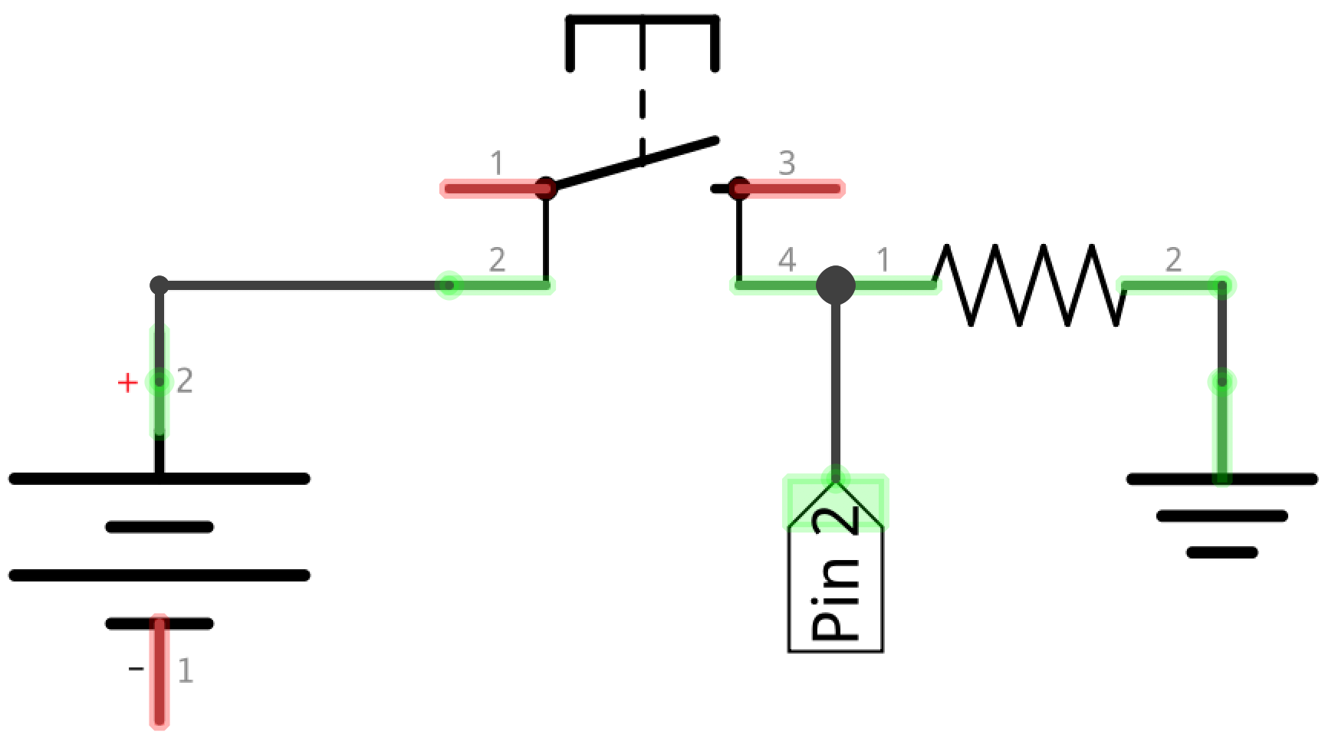

Slide 2
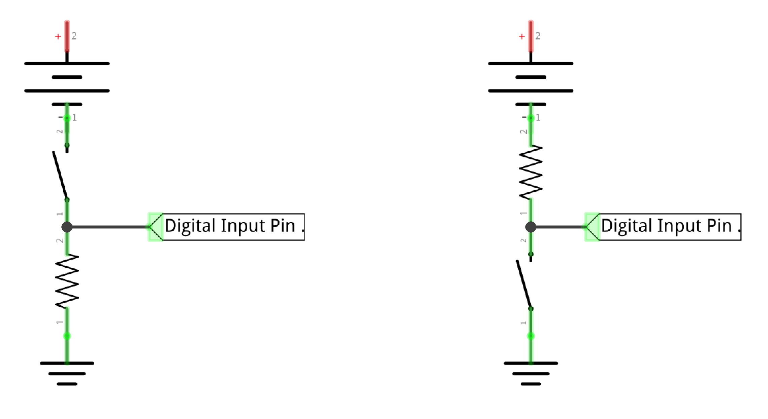

Slide 4
+5V
V_{pin} = 0V
GND

Slide 5
+5V
V_{pin} = 0V
V_{pin} = 5V
GND

Slide 6
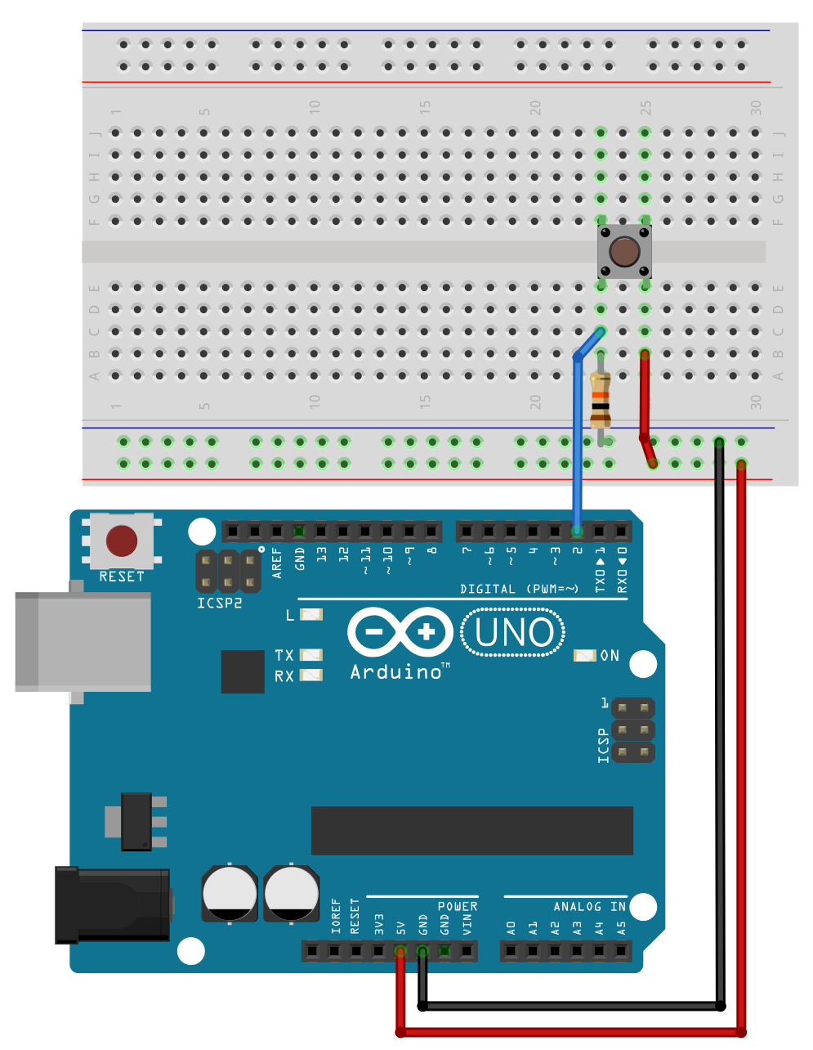
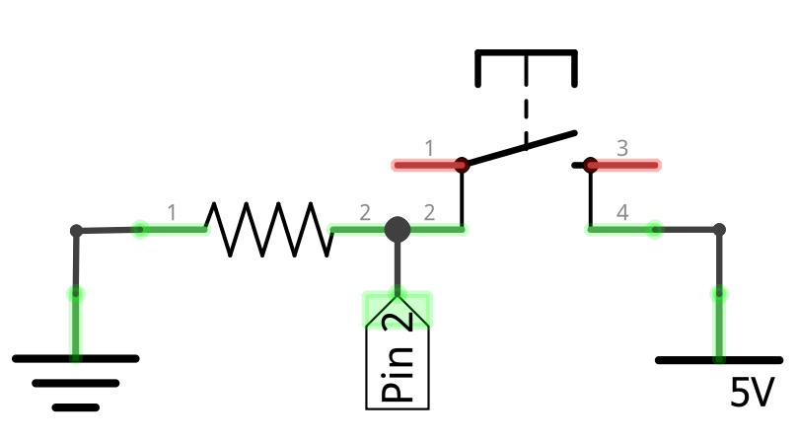
Pull-down Resistor Configuration
Push Button (4-Leg)
10KΩ
5V
GND
Vcc
Notes:
Pull-down resistor configuration

Slide 7
Pull-down Resistor Configuration
Push Button (4-Leg)
10KΩ
5V
GND
Vcc
Notes:
Pull-down resistor configuration

Slide 8
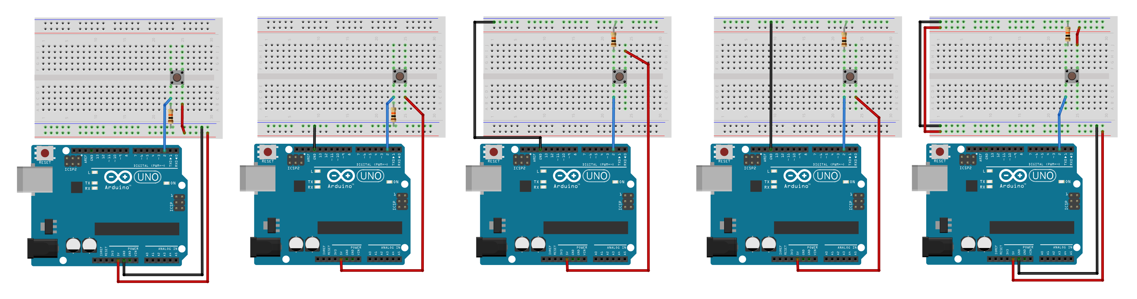

Slide 9
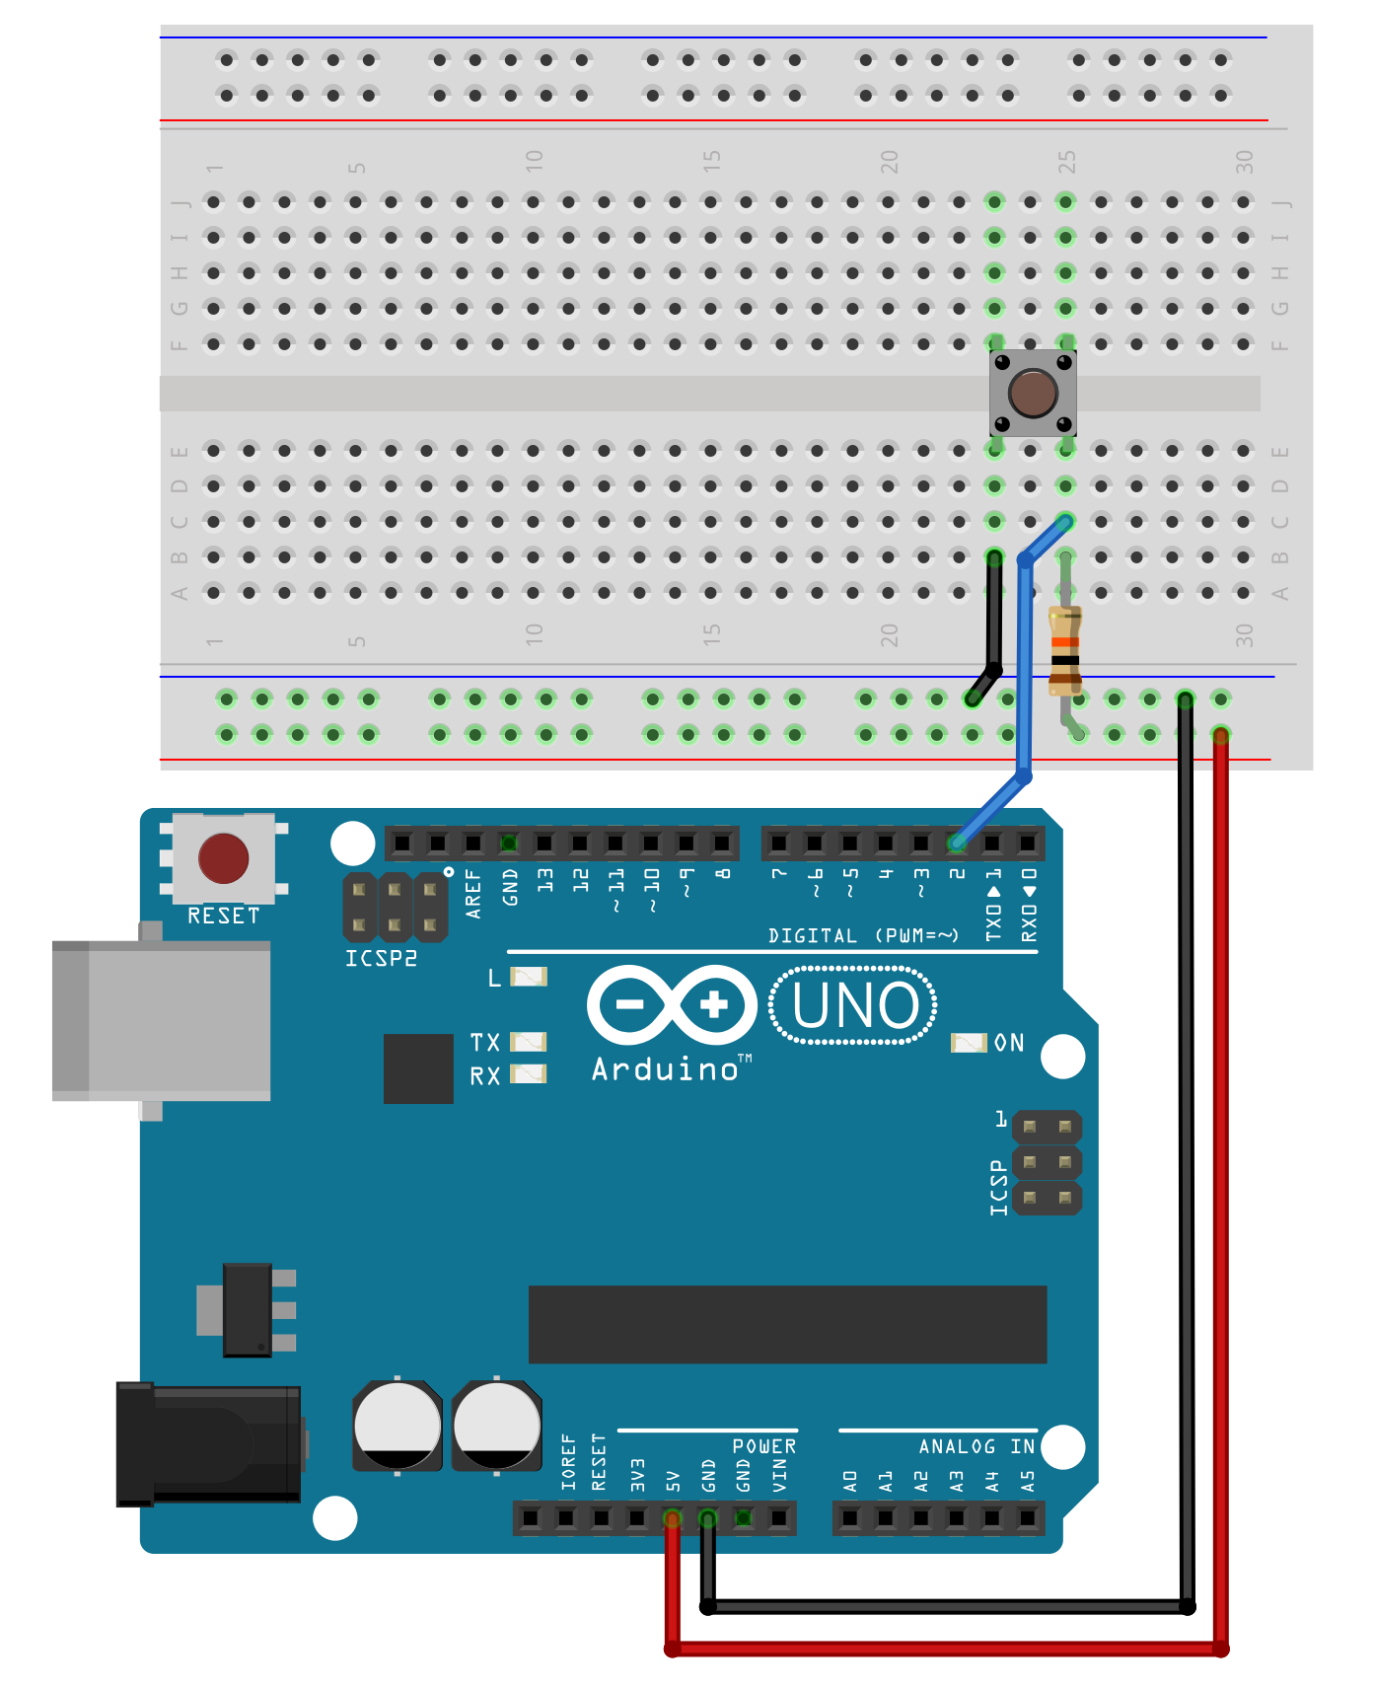
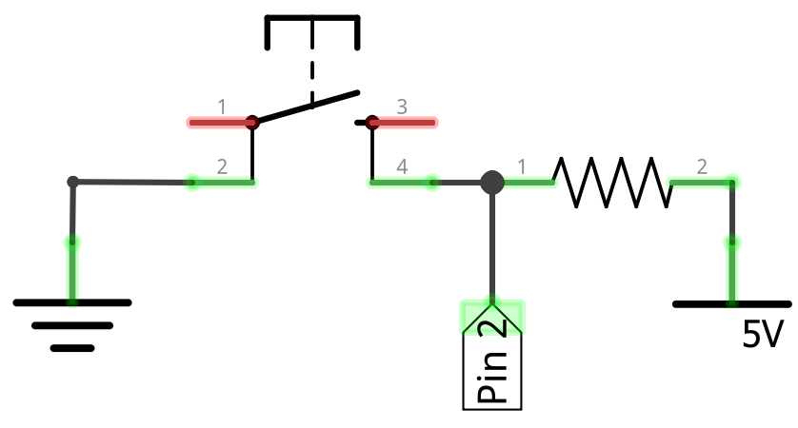
Pull-Up Resistor Configuration
Push Button (4-Leg)
10KΩ
GND
5V
Vcc

Slide 10
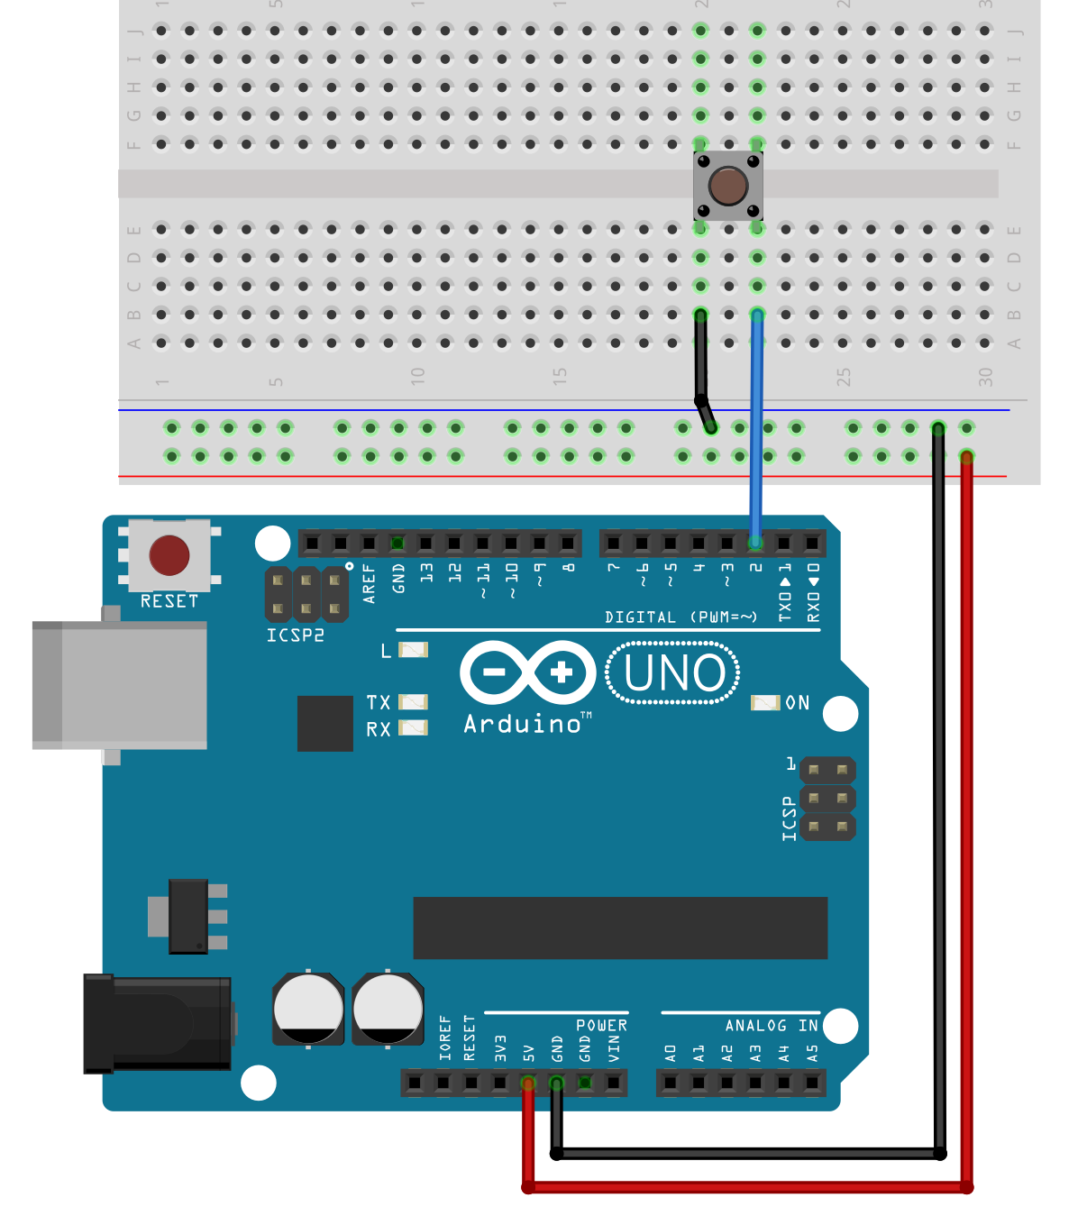
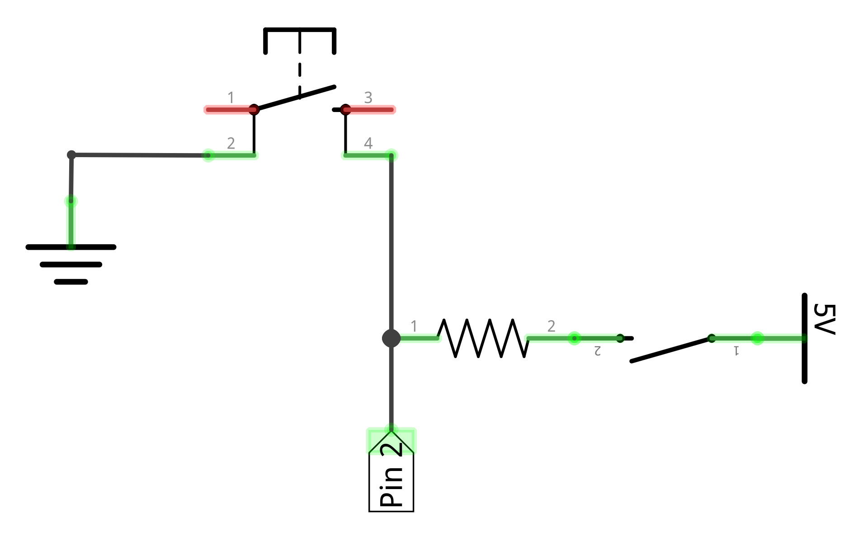
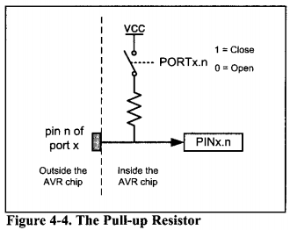
Internal Pull-up Resistor Configuration
Push Button (4-Leg)
Pin 2
Outside Microcontroller
GND
Inside Microcontroller
20KΩ
Software controlled switch enabled by INPUT_PULLUP
Notes:
Based on https://electronics.stackexchange.com/q/185953

Slide 11
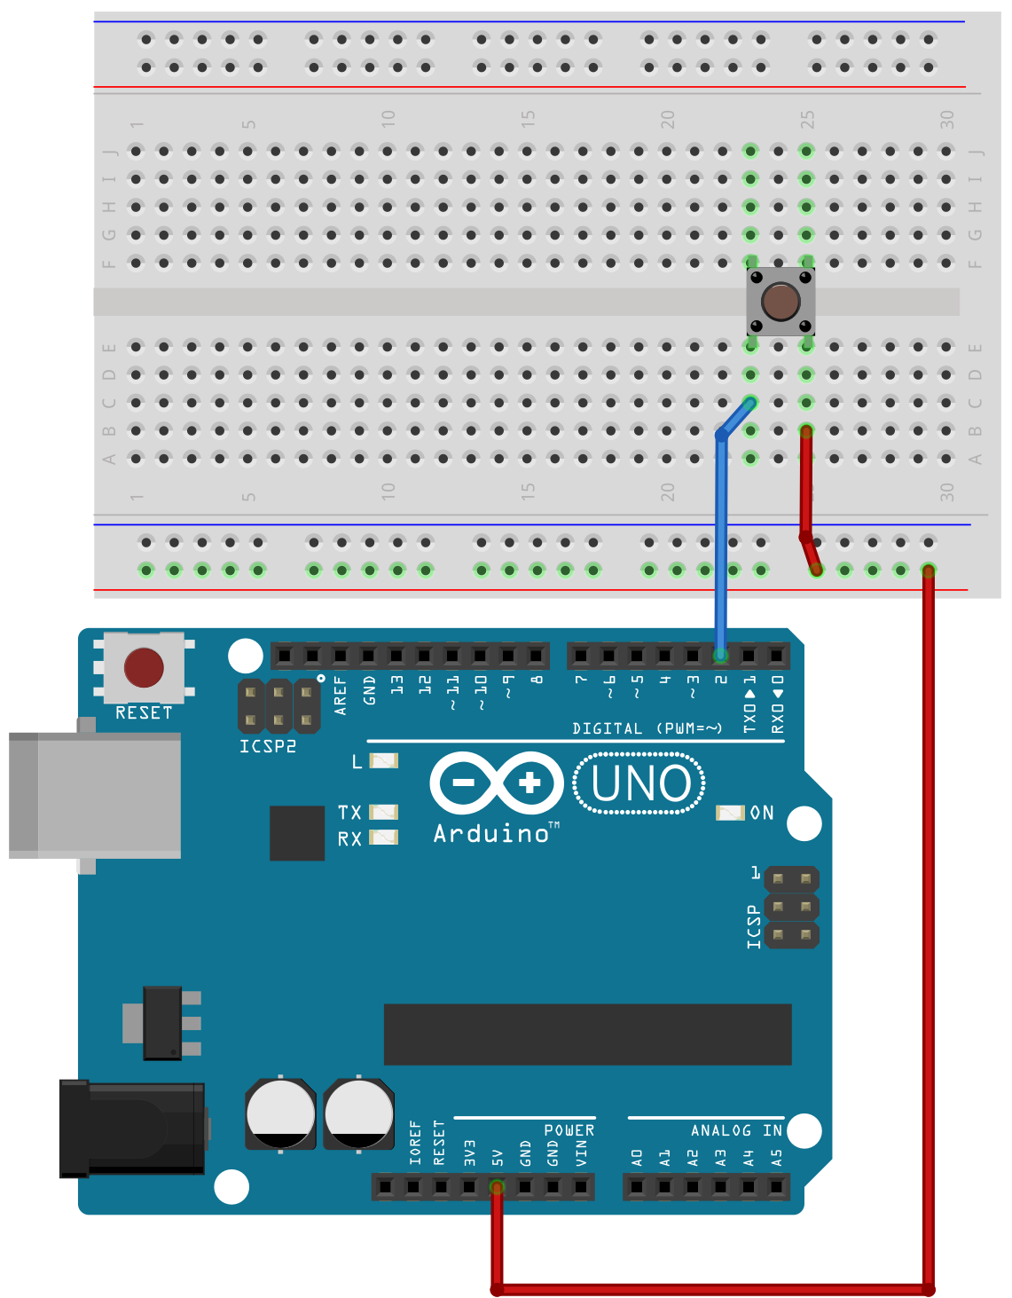
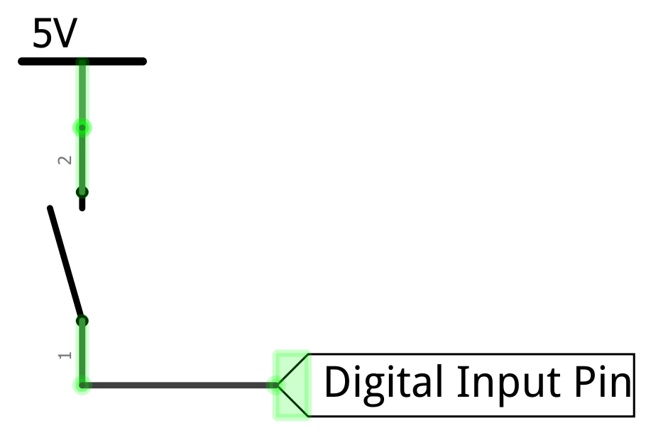

Slide 12
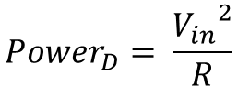
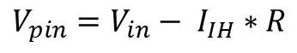
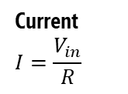
Selecting a pull-up resistor value
On the ATmega328, V_{pin} needs to be > 3V to qualify as HIGH and < 1.5V to qualify as LOW. The in-between voltage range (1.5V-3V) is undefined.
Switch open, input HIGH
Switch closed, input LOW
V_{in}
V_{in}
Input leakage current I_{IH} = ~1µA
Microcontroller
Microcontroller
R=10KΩ
R=10KΩ
Current $$I=\frac{V_{in}}{R}$$
V_{pin}
V_{pin}
Input Pin
Input Pin
GND
GND
$$V_{pin}=V_{in}− I_{IH}∗R$$
$${Power}_{D}= \frac{{V_{in}}^{2}}{R}$$

Slide 14
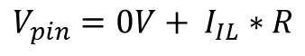
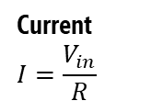
Selecting a pull-down resistor value
On the ATmega328, V_{pin} needs to be > 3V to qualify as HIGH and < 1.5V to qualify as LOW. The in-between voltage range (1.5V-3V) is undefined.
Switch open, input LOW
Switch closed, input HIGH
V_{in}
V_{in}
Microcontroller
Microcontroller
Input Pin
V_{pin}
Current $$I=\frac{V_{in}}{R}$$
Input Pin
V_{pin}
R=10KΩ
Output leakage current I_{IL} = ~1µA
R=10KΩ
GND
GND
$$V_{pin}=0V+ I_{IL}∗R$$
$${Power}_{D}= \frac{{V_{in}}^{2}}{R}$$

Slide 15

Open

Slide 16
Open

Slide 17
Button pressed!
The input pin is now 5V
digitalRead(2)returns HIGH
Closed

Slide 18
Button not pressed!
But what does the input pin read when the button is not pressed?
The pin can oscillate between HIGH and LOW. This is called a floating pin!
Open

Slide 19
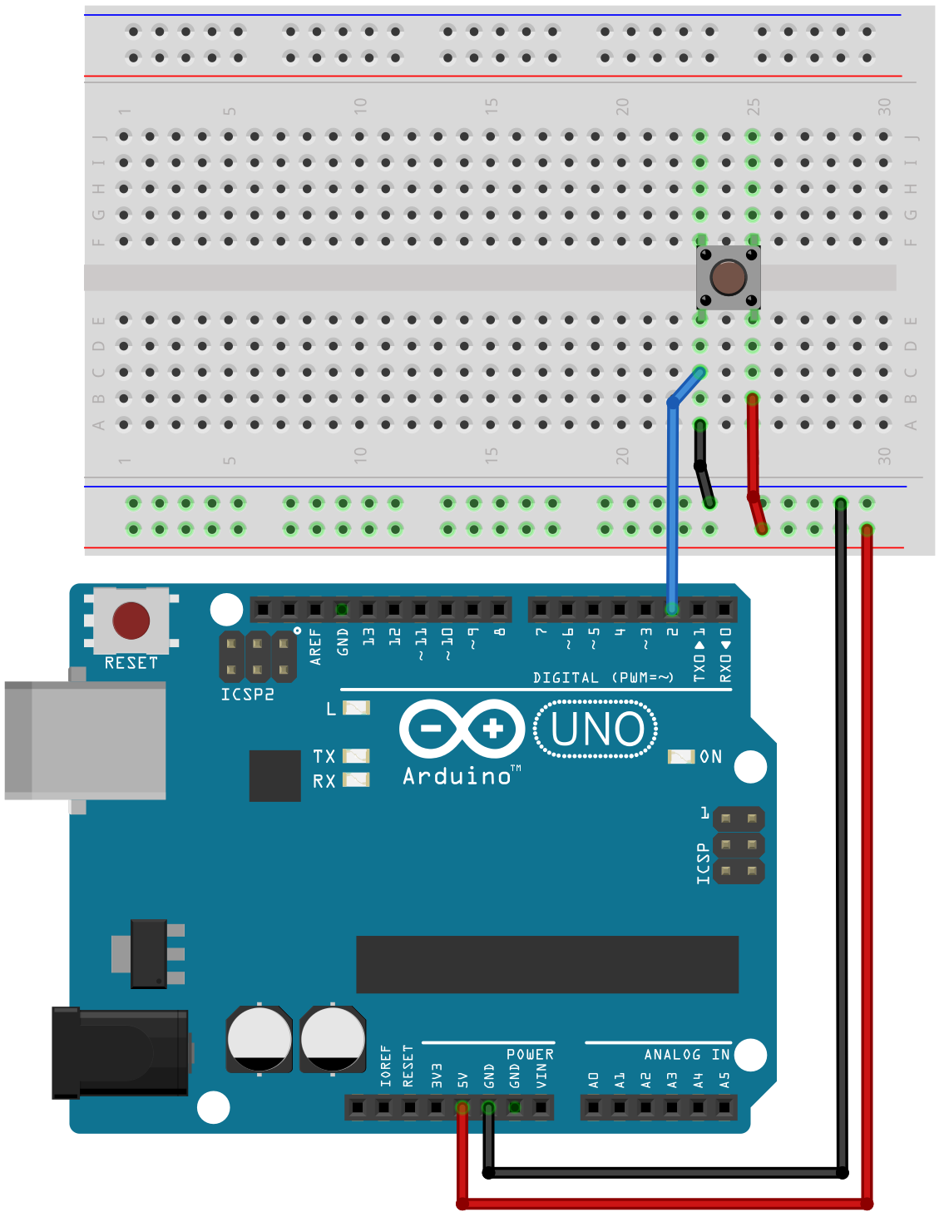
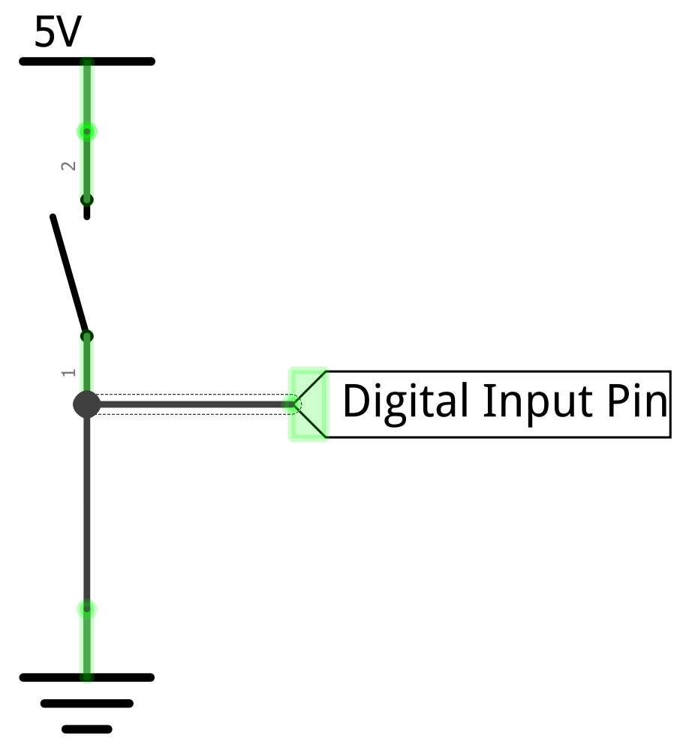
To solve the floating pin problem, you might think to add a GND connection
Open

Slide 20
To solve the floating pin problem, you might think to add a GND connection
Added GND wire
Open
Add GND here

Slide 21
To solve the floating pin problem, you might think to add a GND connection
Button not pressed!
Open
Now, with the switch open, the input pin is 0V rather than floating
So, digitalRead(2)returns LOW

Slide 22
Now, with the switch open, the input pin is 0V rather than floating
So, digitalRead(2)returns LOW
Button not pressed!
Open

Slide 23
However… now what happens when we press the button?
Button not pressed!
Open

Slide 24
However… now what happens when we press the button?
Button not pressed!
Open

Slide 25

A short circuit!
This can damage our microcontroller
Button pressed!
Closed

Slide 26
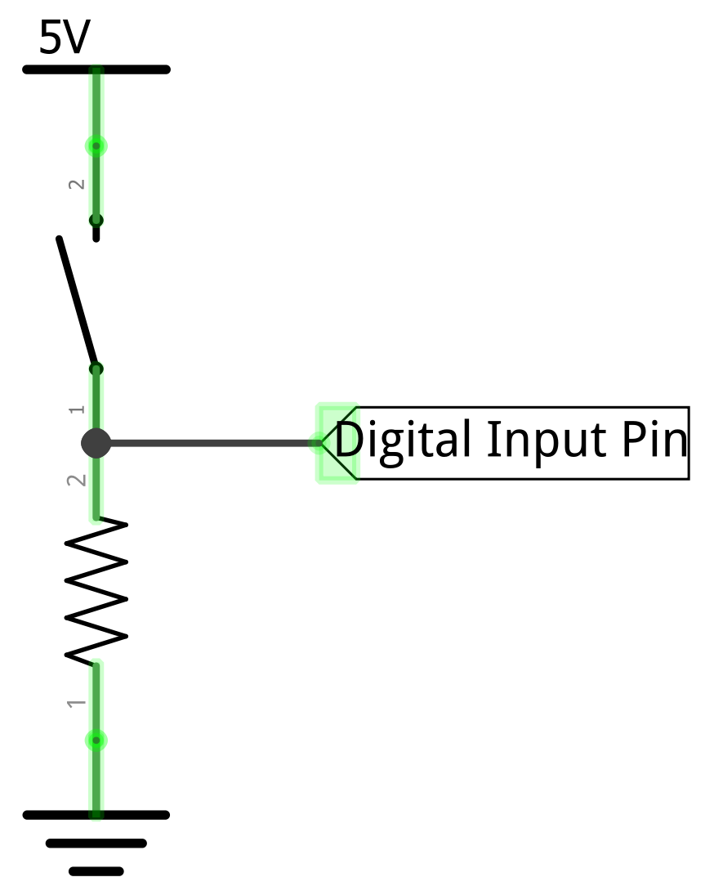
So, we add a pull-down resistor

Slide 27
So, we add a pull-down resistor
Added pull-down resistor
This resistor “pulls down” the digital input pin to GND when the switch is open

Slide 28
Now, with the switch open, the input pin is pulled down to 0V
So, digitalRead(2)returns LOW
Button not pressed!
Open

Slide 29
And with the switch closed, the input pin becomes 5V, and the pull-down resistor prevents a short circuit
So, digitalRead(2)returns HIGH
Button pressed!
Closed

